Slide 1
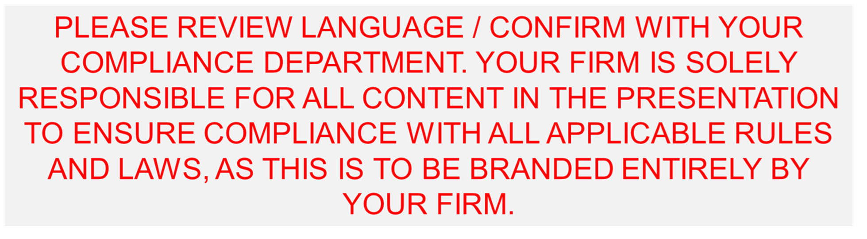
Market Volatility
March 2025

Slide 2
Disclosure
This report is intended for the exclusive use of clients or prospective clients (the “recipient”) of Fiducient Advisors and the information contained herein is confidential and the dissemination or distribution to any other person without the prior approval of Fiducient Advisors is strictly prohibited. Information has been obtained from sources believed to be reliable, though not independently verified. Any forecasts are hypothetical and represent future expectations and not actual return volatilities and correlations will differ from forecasts. This report does not represent a specific investment recommendation. The opinions and analysis expressed herein are based on Fiducient Advisor research and professional experience and are expressed as of the date of this report. Please consult with your advisor, attorney and accountant, as appropriate, regarding specific advice. Past performance does not indicate future performance and there is risk of loss.

Slide 3
Preface
The following slides provide important context on market volatility. In times of uncertainty, it’s easy for emotions to drive decision-making. However, emotions can often lead us astray, making it harder to stay focused on long-term goals. Taking a step back helps us to see the bigger picture, revealing opportunities and reinforcing the importance of a disciplined, long-term approach to navigating inevitable market and economic volatility.
"The stock market is a device for transferring money from the impatient to the patient.“
— Warren Buffett

Slide 4
Fiducient’s Approach to Managing Through Volatility
Market and economic volatility are inevitable and often uncomfortable. While no two market cycles are exactly alike, our investment philosophy is designed to navigate uncertainty with discipline and foresight with a focus on long-term outcomes. Our approach is grounded by three key principles that help guide portfolios through turbulent periods:
1. Dynamic Capital Market Assumptions (CMAs)
Markets evolve and so do our views. Our Capital Markets Team meets monthly, or more frequently as needed, to reassess opportunities and risks as valuations shift. With a long-term investment perspective as you would expect, allocations do not often shift materially month over month. However, when market conditions move meaningfully, we adjust portfolios to manage risk more effectively while positioning for emerging opportunities.
2. Real-World Assumptions in Portfolio Modeling
Market downturns are a natural part of the investment cycle, historically occurring every three years on average. Our portfolio construction process reflects this reality by stress-testing portfolios against thousands of market environments, including extreme tail-risk events. This disciplined approach leads to thoughtfully diversified allocations that are not overly dependent on favorable conditions to succeed.
3. Rebalancing with Discipline
Rebalancing is one of the most effective tools for navigating volatile markets. By systematically adjusting allocations, we ensure portfolios remain aligned with their intended risk profile. Often this means adding to risk assets when volatility is high, an approach that requires discipline but has historically driven long-term success. Our Portfolio Engineer rebalancing methodology helps us execute rebalancing strategies thoughtfully, avoiding reactive, short-term decision-making. This disciplined execution ensures that portfolios stay on track, even in the face of market uncertainty.

Slide 5
With The Right Time Horizon, The Outlook is Bright
S&P 500 Calendar Year Annualized Forward Returns
% of Periods with Positive Outcomes
1 Year | 81%
3 Years | 79%
5 Years | 81%
10 Years | 91%
>10 Years | 100%
This table shows the forward returns x years out (first column), starting from a particular year (the top row). The first row represents the calendar year return for each year. For example, starting in 2008 the annualized 4-year realized forward return was -2% and starting in 2013, the annualized 3-year realized forward return was 15%.
Source: Morningstar. As of December 31, 2024. S&P 500 returns are annual total returns from 1994 to 2024.
See disclosures for list of indices representing each asset class. Past performance does not indicate future performance and there is a possibility of a loss. Indices cannot be invested in directly.

Slide 6
May the Skew Be in Your Favor
S&P 500 Annual Total Returns Since 1971
See disclosures for list of indices representing each asset class. Past performance does not indicate future performance and there is a possibility of a loss. Indices cannot be invested in directly.

Slide 7
Intra-Year Drawdowns Are Common & Don’t Define the Year
S&P 500 Annual Returns vs Drawdown
See disclosures for list of indices representing each asset class. Past performance does not indicate future performance and there is a possibility of a loss. Indices cannot be invested in directly.

Slide 8
Looking Past Volatility is Often Profitable
Drawdowns Larger than 15% Since 1987
Sources: Morningstar, Yardeni Research Inc. As of December 31, 2024. S&P 500 returns are price returns.
The average 12 month forward return is 41% following drawdowns of 15% or more.
See disclosures for list of indices representing each asset class. Past performance does not indicate future performance and there is a possibility of a loss. Indices cannot be invested in directly.

Slide 9
Correction, Bear Markets & Recessions are a NORMAL Thing
Frequency of Market Events Since 1950
Environment | -5% or more | -10% or more | -15% or more | -20% or more | Recession
Average Frequency | About once a year | About once every three years | About once every five years | About once every seven years | About every six and a half years
Average Length | 114 Days | 258 Days | 340 Days | 412 Days | 308 Days
Sources: Morningstar, National Bureau of Economic Research. As of December 31, 2024.

Slide 10
Corrections and Bear Markets through the Years
S&P 500 Returns After Trough
Year | 30 Days After Trough | 60 Days After Trough | 90 Days After Trough | 180 Days After Trough | 360 Days After Trough
1970 (Bear) | 1.40% | 8.47% | 20.00% | 37.27% | 41.74%
1971 (Corr) | 12.45% | 15.68% | 18.04% | 19.40% | 23.59%
1974 (Bear) | 15.27% | 6.41% | 23.95% | 42.13% | 60.00%
1974 (Corr) | 7.30% | 23.38% | 27.29% | 30.59% | 54.68%
1975 (Corr) | 9.21% | 5.33% | 19.28% | 20.04% | 23.72%
1978 (Corr) | 8.00% | 10.44% | 8.94% | 6.50% | 16.17%
1978 (Corr) | 4.71% | 5.28% | 7.91% | 9.49% | 9.72%
1979 (Corr) | 6.92% | 13.83% | 5.60% | 18.21% | 35.48%
1980 (Corr) | 7.55% | 16.19% | 23.30% | 38.31% | 35.30%
1982 (Bear) | 20.67% | 38.27% | 31.87% | 55.99% | 60.68%
1984 (Corr) | 10.69% | 10.63% | 11.64% | 21.20% | 37.22%
1987 (Bear) | 11.92% | 16.54% | 19.64% | 16.58% | 37.48%
1990 (Corr) | 3.32% | 1.59% | 12.74% | -6.18% | 16.42%
1990 (Corr) | 5.21% | 7.16% | 21.25% | 24.98% | 37.77%
1997 (Corr) | 4.33% | 2.11% | 11.26% | 22.91% | 38.83%
1998 (Corr) | -2.87% | 15.68% | 19.57% | 30.49% | 42.64%
1999 (Corr) | 10.38% | 12.31% | 4.88% | 12.32% | -3.84%
2002 (Bear) | 14.48% | 10.18% | 2.52% | 26.49% | 43.22%
2003 (Corr) | 12.87% | 20.32% | 23.89% | 28.07% | 35.59%
2009 (Bear) | 21.80% | 37.97% | 31.85% | 62.32% | 63.16%
2010 (Corr) | 5.05% | 11.81% | 19.32% | 26.95% | 18.33%
2011 (Corr) | 10.64% | 11.84% | 18.82% | 15.69% | 34.33%
2015 (Corr) | 4.58% | 8.30% | 9.78% | 8.99% | 19.84%
2016 (Corr) | 9.94% | 10.73% | 12.21% | 15.63% | 30.66%
2018 (Corr) | -1.42% | -1.94% | 3.76% | 3.25% | 9.07%
2018 (Corr) | 12.76% | 17.23% | 21.78% | 21.10% | 21.26%
2020 (Bear) | 23.33% | 33.05% | 40.54% | 57.13% | 92.30%
2022 (Bear) | 12.22% | 7.36% | 15.57% | 21.65% | 41.26%
2023 (Corr) | 11.29% | 16.98% | 24.17% | 34.56% | N/A
Average | 9.45% | 13.56% | 17.63% | 24.90% | 34.88%
Average (Bear) | 15.14% | 19.78% | 23.24% | 39.94% | 54.98%
Average (Corr) | 7.28% | 11.19% | 15.50% | 19.17% | 26.84%
Market Correction Stats
Average Frequency: About once every 3 years since 1970
Average Length: 107 days
Average Drawdown: -14.51%
Bear Markets Stats
Average Frequency: About once every 7 years since 1970
Average Length: 457 days
Average Drawdown: -38.76%
Sources: Morningstar, Yardeni Research Inc. As of December 31, 2024. S&P 500 returns are price returns.
See disclosures for list of indices representing each asset class. Past performance does not indicate future performance and there is a possibility of a loss. Indices cannot be invested in directly.

Slide 11
Recessions Through the Years
S&P 500 Returns During and Post Recessions
Recession
Start | End | Months | Peak to Trough Returns | Trough + 1 Year | Trough + 3 Years
Jul-53 | May-54 | 10 | 17.1% | 34.3% | 61.9%
Aug-57 | Apr-58 | 8 | -12.5% | 31.7% | 54.5%
Apr-60 | Feb-61 | 10 | 11.9% | 11.4% | 24.7%
Dec-69 | Nov-70 | 11 | -11.3% | 13.2% | 30.1%
Nov-73 | Mar-75 | 16 | -24.7% | 22.2% | 6.7%
Jan-80 | Jul-80 | 6 | 6.5% | 14.9% | 47.2%
Jul-81 | Nov-82 | 16 | 3.2% | 22.3% | 42.0%
Jul-90 | Mar-91 | 8 | 3.5% | 12.4% | 27.3%
Mar-01 | Nov-01 | 8 | -12.6% | -16.4% | 6.6%
Dec-07 | Jun-09 | 18 | -36.3% | 18.5% | 42.6%
Feb-20 | Apr-20 | 2 | -23.4% | 53.7% | 59.0%
Average |  | 10 | -7.1% | 19.8% | 36.6%
Median |  | 10 | -11.3% | 18.5% | 42.0%
Sources: Morningstar, National Bureau of Economic Research. As of December 31, 2024. S&P 500 returns are monthly price returns.
Recession Stats (since 1950)
Number of Recessions: 11
Frequency: Roughly every 6.5 years
Recover Time: 17 months return to previous peak
Recession Stats (since 1950)
Duration: 10 months
Longest – Global Financial Crisis (18 months)
Shortest – COVID (2 months)
Performance: -26%
Average duration of Decline – 5.5 months
See disclosures for list of indices representing each asset class. Past performance does not indicate future performance and there is a possibility of a loss. Indices cannot be invested in directly.

Slide 12
This Too Shall Pass
Stocks, Bonds, and Inflation: Monthly Returns since 1926
See disclosures for list of indices representing each asset class. Past performance does not indicate future performance and there is a possibility of a loss. Indices cannot be invested in directly.

Slide 13
Dangers of Timing the Market
Missing the Best Days in the Market, Growth of $10,000 from 1988 - 2024
Ending Value:
Annual Return:
See disclosures for list of indices representing each asset class. Past performance does not indicate future performance and there is a possibility of a loss. Indices cannot be invested in directly.

Slide 14
Emotions Often a False Indicator of Opportunity
Consumer Sentiment and Subsequent 12-month S&P 500 Returns
See disclosures for list of indices representing each asset class. Past performance does not indicate future performance and there is a possibility of a loss. Indices cannot be invested in directly.

Slide 15
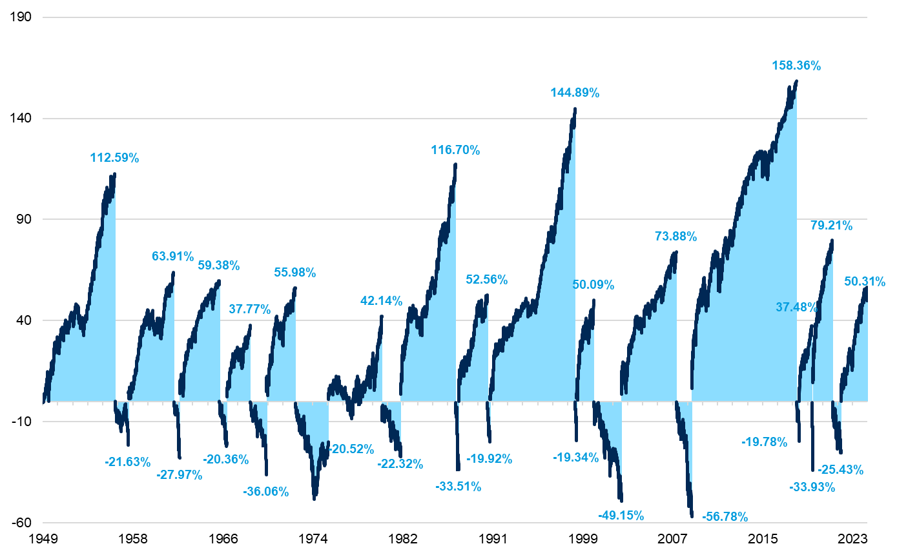
Corrections Are Points IN Time, Wealth Creation Happens OVER Time
Cumulative Return of S&P 500 in Up Markets vs Cumulative Drawdowns in Bear Markets
Sources: Morningstar. As of December 31, 2024. S&P 500 returns are price returns.

Slide 16
Disclosures
This report is intended for the exclusive use of clients or prospective clients (the “recipient”) of Fiducient Advisors and the information contained herein is confidential and the dissemination or distribution to any other person without the prior approval of Fiducient Advisors is strictly prohibited. Information has been obtained from sources believed to be reliable, though not independently verified. Any forecasts are hypothetical and represent future expectations and not actual return volatilities and correlations will differ from forecasts. This report does not represent a specific investment recommendation. The opinions and analysis expressed herein are based on Fiducient Advisor research and professional experience and are expressed as of the date of this report. Please consult with your advisor, attorney and accountant, as appropriate, regarding specific advice. Past performance does not indicate future performance and there is risk of loss.
When referencing asset class returns or statistics, the following indices are used to represent those asset classes, unless otherwise noted. Each index is unmanaged, and investors can not actually invest directly into an index:
Stocks represented by Ibbotson’s SBBI US Large Stock Total Return from January 1, 1926 to December 31, 1987 and S&P 500 Total Return from January 1, 1988 to December 31, 2024.
Bonds represented by Ibbotson’s SBBI US IT Govt Total Return from January 1, 1926 to December 31, 1987 and Bloomberg U.S. Aggregate Bond Index Total Return from January 1, 1988 to December 31, 2024.
Inflation is measured by the Consumer Price Index (CPI).
Consumer Sentiment Index is measured by the University of Michigan Survey of Consumers.
Disclosures – Index & Benchmark Definitions
Fixed Income
Bloomberg U.S. Aggregate Index covers the U.S. investment grade fixed rate bond market, with index components for government and corporate securities, mortgage pass-through securities, and asset-backed securities.
IA SBBI US IT Government index measures the performance of a single issue of outstanding US Treasury note with a maturity term of around 5.5 years. It is calculated by Morningstar. Returns for 1934 to 1986 are obtained from the CRSP Government Bond File and returns for 1987 to 2014 are calculated from The Wall Street Journal prices.
Equity
The S&P 500 Index is a capitalization-weighted index designed to measure performance of the broad domestic economy through changes in the aggregate market value of 500 stocks representing all major industries.
IA SBBI US Large Stock index tracks the monthly return of S&P 500. The history data from 1926 to 1969 is calculated by Ibbotson.
Other
Consumer Price Index (CPI) is a measure of the average change over time in the prices paid by urban consumers for a market basket of consumer goods and services. Indexes are available for the U.S. and various geographic areas. Average price data for select utility, automotive fuel, and food items are also available.
Consumer Sentiment Index focuses on three areas: how consumers view prospects for their own financial situation, how they view prospects for the general economy over the near term, and their view of prospects for the economy over the long term. The Expectations Index represents only a small part of the entire survey data that is collected on a regular basis. Each monthly survey contains approximately 50 core questions, each of which tracks a different aspect of consumer attitudes and expectations. The samples for the Surveys of Consumers are statistically designed to be representative of all American households, excluding those in Alaska and Hawaii. Each month, a minimum of 600 interviews are conducted by telephone from the Ann Arbor facility.

Slide 17
Disclosures – Material Risks & Limitations
Fixed Income securities are subject to interest rate risks, the risk of default and liquidity risk. U.S. investors exposed to non-U.S. fixed income may also be subject to currency risk and fluctuations.
Cash may be subject to the loss of principal and over longer period of time may lose purchasing power due to inflation.
Domestic Equity can be volatile. The rise or fall in prices take place for a number of reasons including, but not limited to changes to underlying company conditions, sector or industry factors, or other macro events. These may happen quickly and unpredictably.
International Equity can be volatile. The rise or fall in prices take place for a number of reasons including, but not limited to changes to underlying company conditions, sector or industry impacts, or other macro events. These may happen quickly and unpredictably. International equity allocations may also be impact by currency and/or country specific risks which may result in lower liquidity in some markets.
Real Assets can be volatile and may include asset segments that may have greater volatility than investment in traditional equity securities. Such volatility could be influenced by a myriad of factors including, but not limited to overall market volatility, changes in interest rates, political and regulatory developments, or other exogenous events like weather or natural disaster.
Private Equity involves higher risk and is suitable only for sophisticated investors. Along with traditional equity market risks, private equity investments are also subject to higher fees, lower liquidity and the potential for leverage that may amplify volatility and/or the potential loss of capital.
Private Credit involves higher risk and is suitable only for sophisticated investors. These assets are subject to interest rate risks, the risk of default and limited liquidity. U.S. investors exposed to non-U.S. private credit may also be subject to currency risk and fluctuations.
Private Real Estate involves higher risk and is suitable only for sophisticated investors. Real estate assets can be volatile and may include unique risks to the asset class like leverage and/or industry, sector or geographical concentration. Declines in real estate value may take place for a number of reasons including, but are not limited to economic conditions, change in condition of the underlying property or defaults by the borrow.
Marketable Alternatives involves higher risk and is suitable only for sophisticated investors. Along with traditional market risks, marketable alternatives are also subject to higher fees, lower liquidity and the potential for leverage that may amplify volatility or the potential for loss of capital. Additionally, short selling involved certain risks including, but not limited to additional costs, and the potential for unlimited loss on certain short sale positions.

